Slide 1
Udacity Data Visualization Nanodegree
Build a Data Story Midterm Project Using The Movies Dataset
By Muhammed Jimoh

Slide 2
Table of Content
Problem Statement
Executive Summary
Synthesis (Hypothesis)
Overview of The Analysis
The Analysis (Usually require more than one slide)
The Limitations & Biases
Next Steps

Slide 3
Problem Statement
What are the key features of the top 5% of movies by rating all have in common?

Slide 4
Executive Summary
The task at hand was to identify the primary factors that contribute to the high rating of the top 5% of movies.
Is it Runtime?
Is it the movie genre?
Is it the movie budget?
Is it the language in which the movie was produced?

Slide 5
Issue Tree
What are the key features of the top 5% of movies by rating all have in common?
i
Is it runtime?
Is it genre?
Is it movie budget?
Is it language?
Yes, longer runtime
Action movie
Not necessarily
Zulu

Slide 6
Synthesis (Hypothesis)
The duration of a movie is a crucial aspect that influences the average rating.
Movies with action or historical genre are expected to receive a higher rating owing to the element of curiosity they generate.
Movies in English should generate higher revenues compared to those in other languages
Movies with a bigger budget tend to receive a higher average rating.

Slide 7
Overview of The Analysis
Analyzing the correlation between the average rating of movies and their respective playback duration.
Examining the relationship between the average rating of movies and their budget.
Evaluating the connection between a movie's genre and its average rating.
Investigating the association between the original language of movies and their average rating.

Slide 8
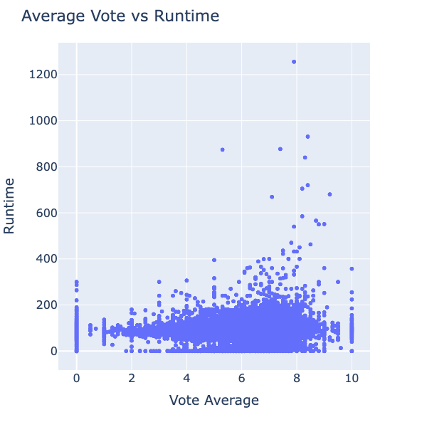
The Analysis
In general, films that run for more than 400 minutes usually get better ratings on average, except for "The War". However, there are cases where movies with a runtime of less than 400 minutes also obtain ratings that are almost as high as 10.

Slide 9
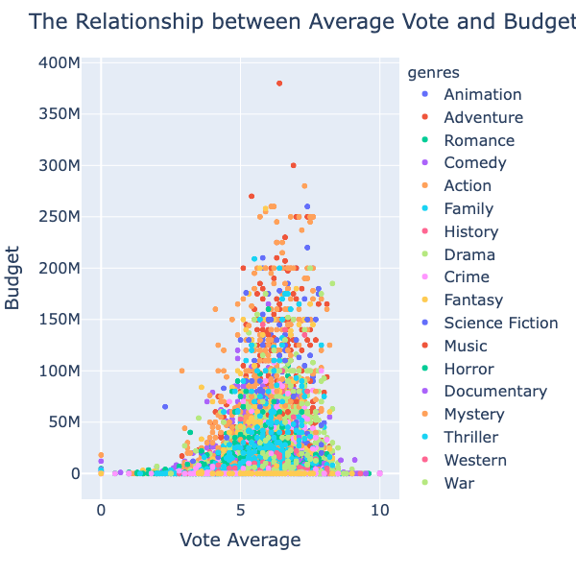
The Analysis
On average, films with budgets exceeding 50 million dollars are more likely to receive higher ratings. Nevertheless, there are exceptions to this trend, as some movies with budgets below this threshold also achieve ratings close to 10.

Slide 10
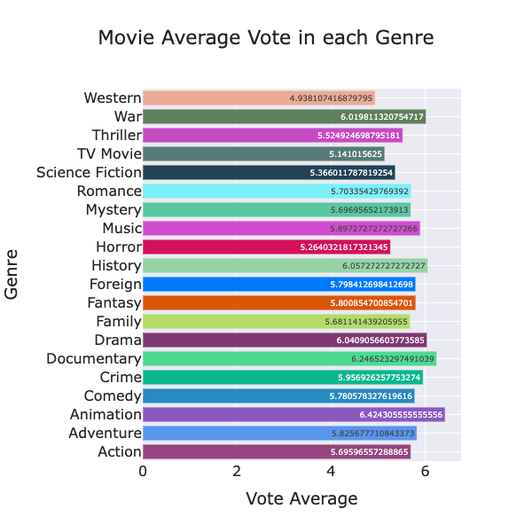
The Analysis
Movies belonging to certain genres received higher average ratings. These include Animation, Documentary, History, Drama, and War films.

Slide 11
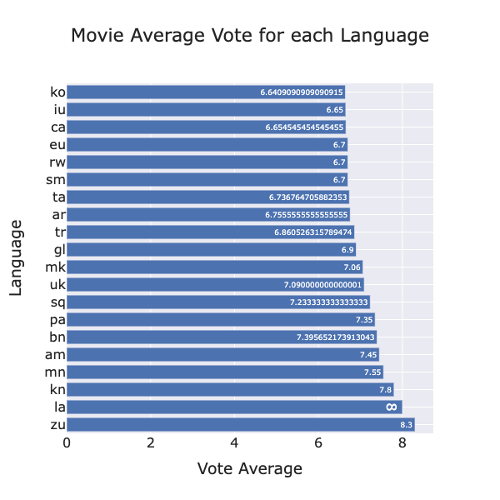
The Analysis
Films that were not in the English language tended to have higher average ratings. More specifically, movies in languages such as Zulu(zu), Latin(la), Kannada(kn), Mongolian(mn), Amharic(am), and Bengali(bn) received higher ratings.

Slide 12
The Limitations & Biases
Limitations:
Messy data e.g some columns contain dictionary or json format
Biases:
Missing values
Outliers

Slide 13
Next Steps
Perform data cleaning:
Classify the movie genres accurately.
Convert the language codes into their corresponding language names.
Separate the country information from the "production_countries" field.
Perform the analysis again, this time taking into account other factors that may indicate increase in average rating.

